Slide 1
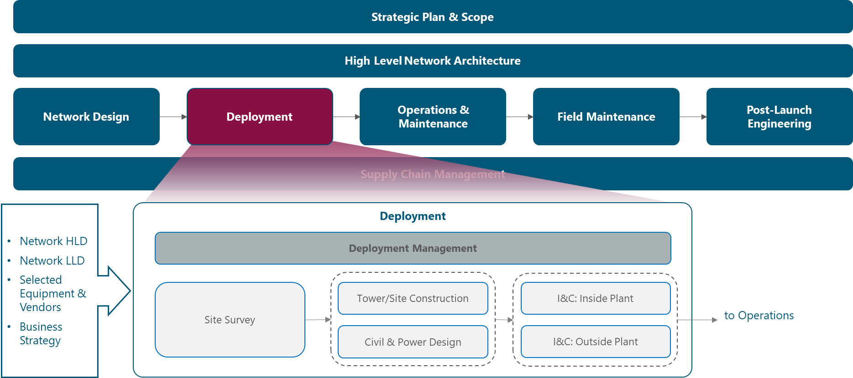
Figure 1 Module Framework

Slide 2
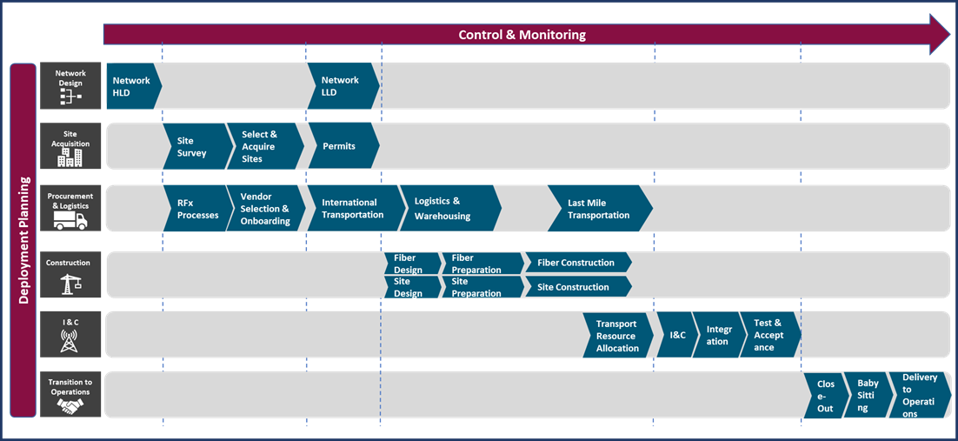
Figure 2 Deployment Management Functional View.

Slide 3
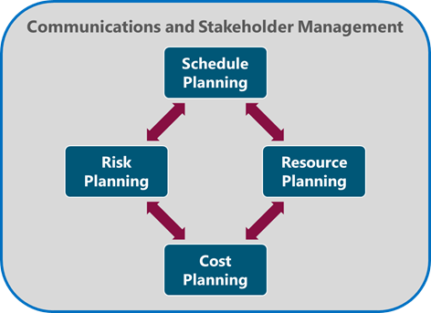
Figure 3 Deployment Planning Process

Slide 4
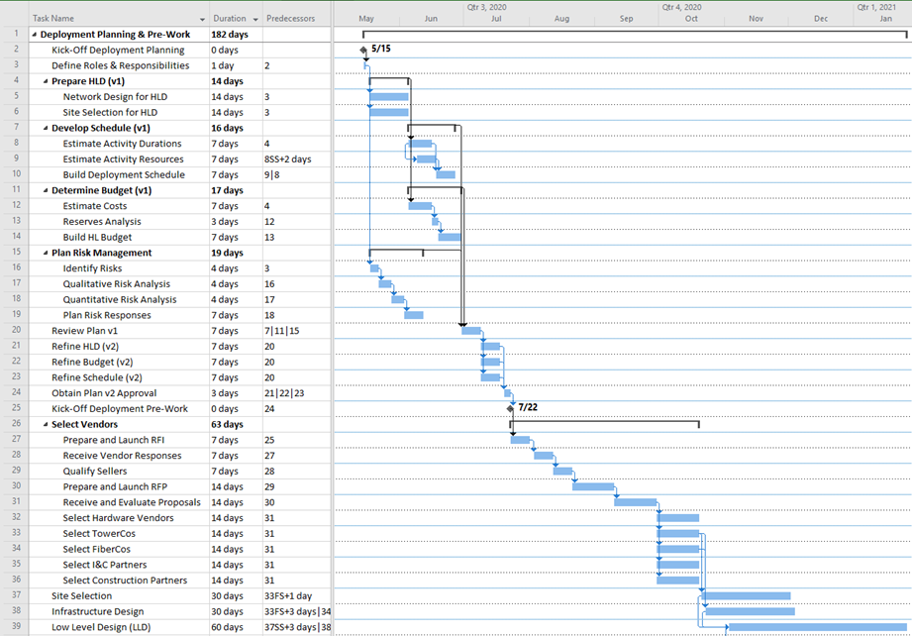
Figure 4. Gantt Chart for Deployment Planning & Pre-Work

Slide 5
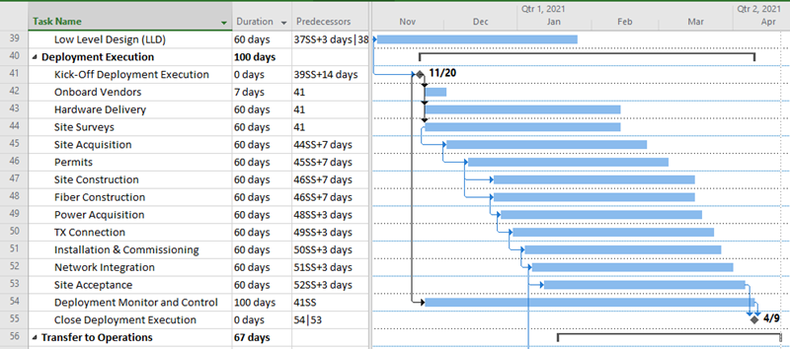
Figure 5. Gantt Chart for Deployment Execution

Slide 6
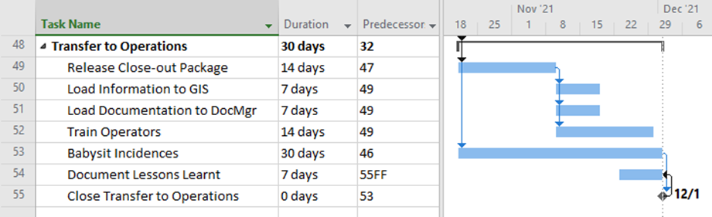
Figure 6. Gantt Chart for Transfer to Operations

Slide 7
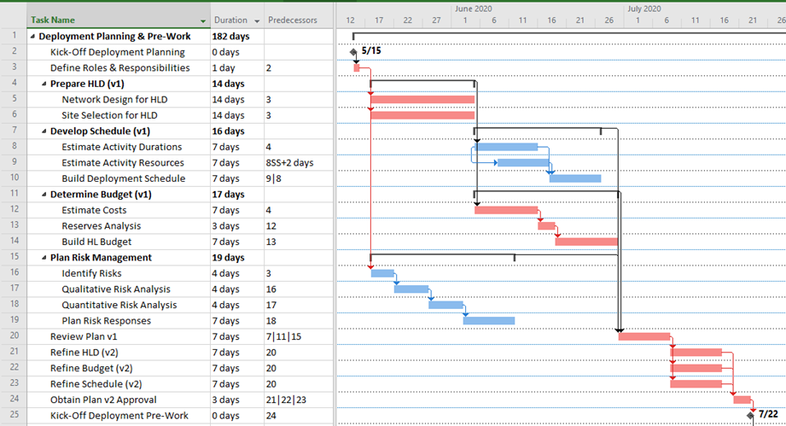
Figure 7. Critical Path highlighted in Planning

Slide 8
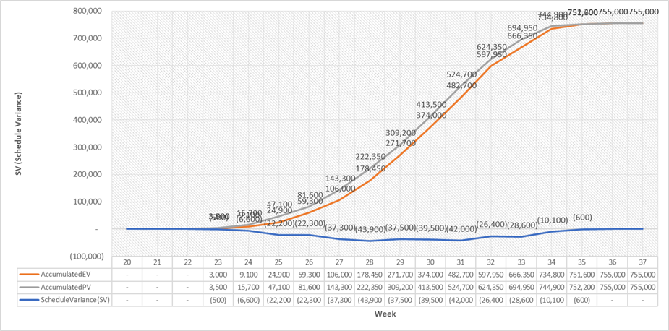
Figure 8 Variances through a project execution

Slide 9
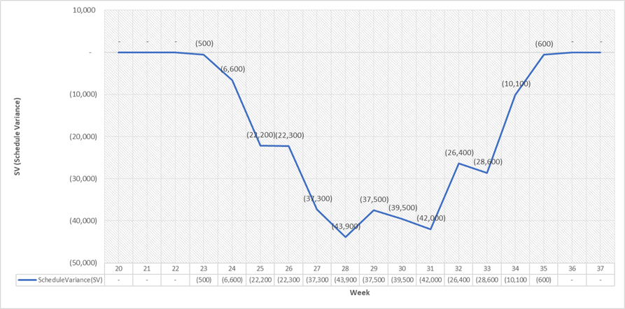
Figure 9. Schedule Variance charts

Slide 10
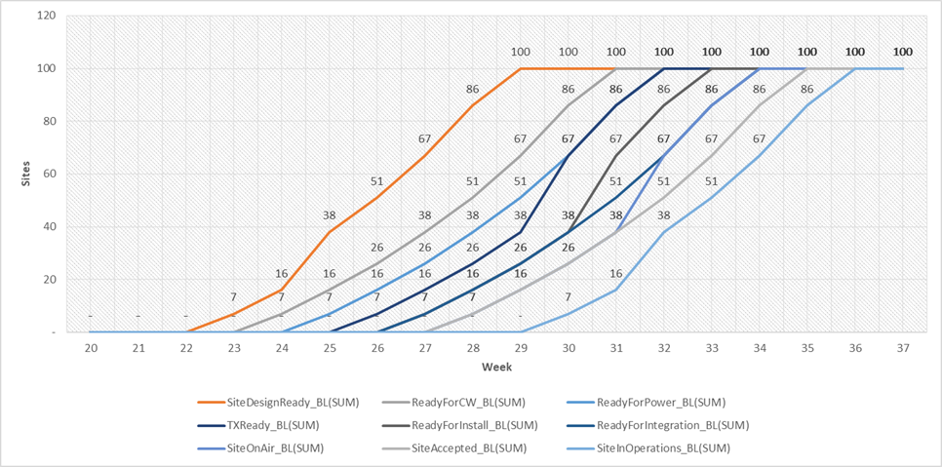
Figure 10. Deployment Schedule Baseline S-Curve Chart

Slide 11
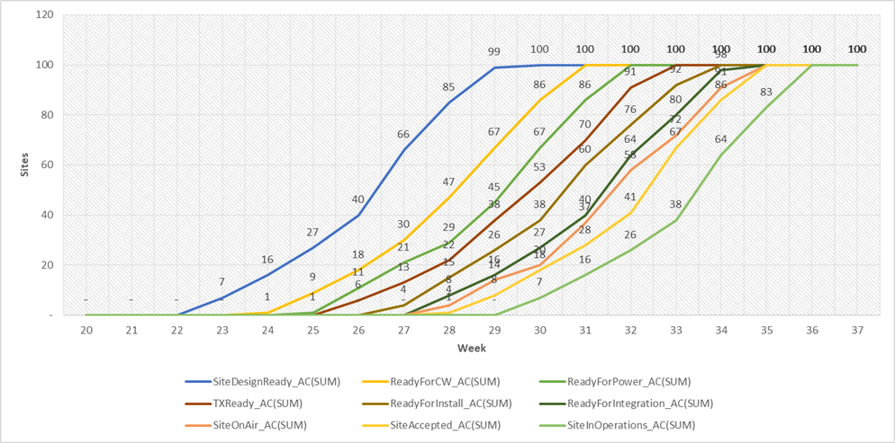
Figure 11. Deployment Schedule Actual S-Curve Chart

Slide 12
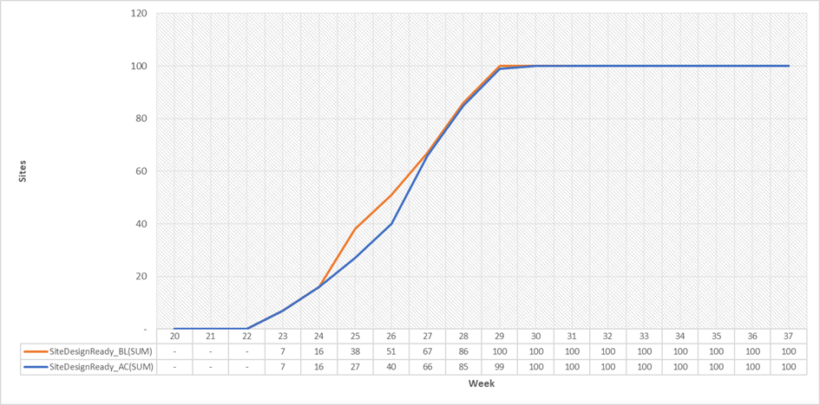
Figure 12. Baseline vs Actual for the Site Design Ready Milestone S-Curves chart

Slide 13
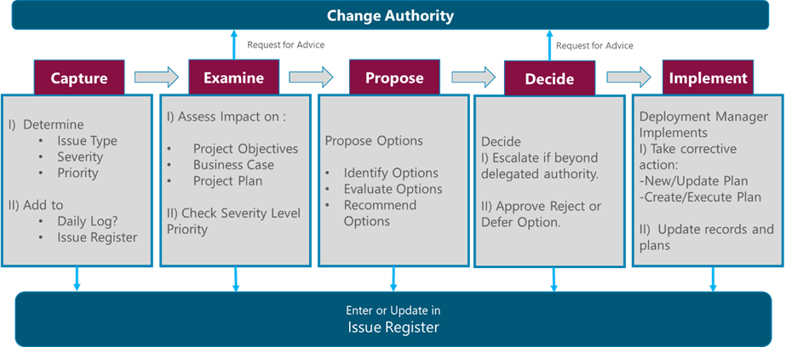
Figure 13 Issue and Change Control Procedure

Slide 14
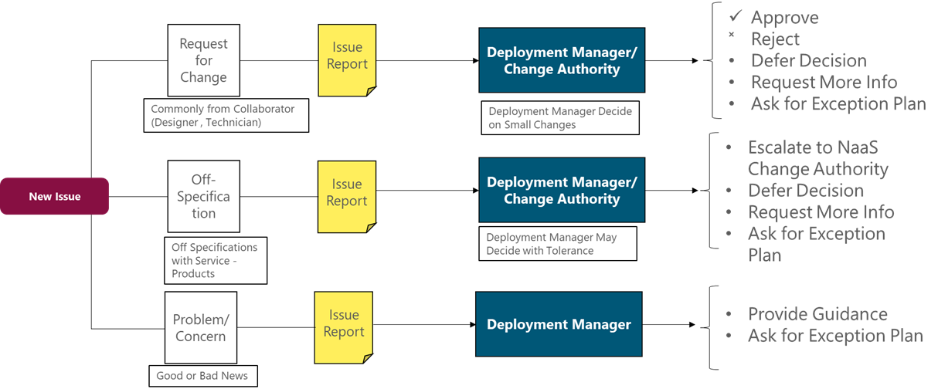
Figure 14 Dealing with Deployment Issues

